Slide 1
Team Status Report
Team Argus - 11/14/2014

Slide 2
SRD Feedback
Peer Review Team : Shoe Per Stars
Customer Requirements
less specifications
wording issues
Other Requirements
Cost analysis were not justified
formatting errors
Acceptance Criteria
needs to be more specific
Need to Add Requirements for SDK

Slide 3
SDK Requirements (Android & PixelSense)
Both SDKs shall allow customizable light sequences.
Both SDKs shall allow send & receive data both ways, i.e Pixelsense & Lynx.
Both SDKs shall allow expansion of Array of Transmitters.
Both SDKs shall notify their respective devices if Lynx is placed on Pixelsense Table.
Pixelsense SDK shall support multiple Lynx devices.

Slide 4
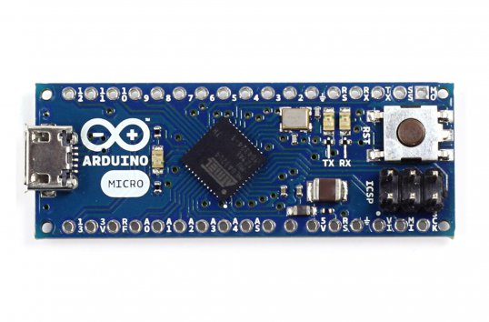
Research Results
Hardware
Headless Arduino Micro
20 I/O
32KB Flash
16MHz Clock Speed
48mm x 18mm
Photodiodes vs Regular LED

Slide 5

Research Results
Software
USB Host Support
Android 3.2+
Compatible Hardware
USB-A or OTG compatible
tablet
OTG Devices can be host
or slave
Protocols for data transfer

Slide 6
Project Plan
Estimations through Architecture Design
Cost Analysis
Planned Cost = 337 hours
Actual Cost = 216 hours
Earned Value = 246 hours
CPI = 1.14
SPI = .73

Slide 7
Project Plan
Cost Analysis - Since last TSR (10/7)
Planned Cost = 230 hours added
Actual Cost = 141 hours completed
Earned Value = 176 hours earned

Slide 8
Risk Assessment
Risk | Probability | Setback (weeks) | Severity
Lack of Experience: PixelSense SDK | 100% | 2 | 2
Integration issues | 50% | 4 | 2
Lack of Experience: Game | 80% | 2 | 1.6
Overestimate abilities/under plan | 30% | 4 | 1.2
Change in Requirements | 35% | 4 | 1.4

Slide 9
Risk Assessment
Risk Containment
Change in Requirements/SRD
Add SDK requirements
Less casino game requirements
Update SRD
Verify changes with sponsor (Dr. Zaruba)

Slide 10
What Is Next
Fine Tune Requirements
Confirm SRD with Sponsor (SDK changes)
Submit Final SRD to supervisor next week
Work on Architecture Design
Further Research (Architecture Related)

